Slide 1

The impact of university-industry cooperation (UIC) on university teachers Országos Neveléstudományi Konferencia Szeged, 2025
Min HUANG
ELTE PPK Doctoral School of Education
Teacher Education and Higher Education Program (EDiTE)
Supervisor: Dr. Gábor HALÁSZ

Slide 2
1.1 Background information : Doctoral research
PhD interest : Higher education; Teacher development; Third mission of universities
Dissertation tile : The impact of third mission activities on university development in China and Hungary with a special focus on university-industry cooperation
Third mission: applying and transforming “knowledge for economic, social and cultural development in the local economy, the country or on a global scale”, which ideally “…enhances education and research…” (OECD, 2017. p. 17.).

Slide 3
1.2 Realization from of third mission-UIC
A central component of third mission is the ability of universities to communicate and collaborate with external stakeholders. University–industry or university–business cooperation (UIC) therefore represents one of the most concrete realizations of the third mission.

Slide 4
1.3. Research Questions for my dissertation
(1) Under what conditions do UIC experiences have positive effects on the quality of the work of university teachers?
(2) How (through what kind of mechanisms) UIC experiences of university teachers are influencing the quality of their work?

Slide 5
1.4. Mix method for my research: qualitative part
Fashion design faculties + business area faculties
Semi-structed interview 18 (fashion design educator from Hungary and China)
UIC strengthens teachers’ instructional skills, self-efficacy, and job satisfaction. It also improves curriculum relevance, fosters pedagogical innovation, and promotes dual professionalism among educators. (Huang & Halász, 2025).

Slide 6
1.5. Using students’ perceptions to analyse the impact of UIC experiences on teachers
The focus of research
University service quality
My field of inquiry
Faculty skills and sense of self-efficacy
UIC
Asking faculty directly (interviews)
Asking students indirectly about their teachers (through student survey)
Student experience

Slide 7
2. Student questionnaire/ quantitative method

Slide 8
2.1 Method
Online student questionnaire (Qualtrics)
business students (below bachelor, bachelor, master, PhD)
Distribution into middle and eastern part of China(vocational, applied and research/comprehensive universities)
N>1100 responses from Chinese students (this is an ongoing research; this is not the final outcome)
Analysis : Composite variables

Slide 9
3. Findings

Slide 10
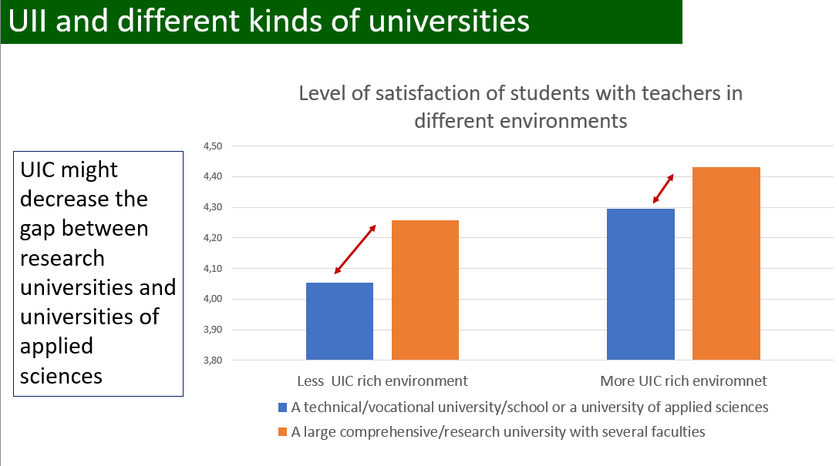
3.1 Satisfaction of students with teachers in function of UIC richness of learning environments (N=1206)
Finding 1: Students learning in more UIC rich environment are more satisfied with their teachers
Satisfaction level
Notes:
Using 1-5 level to measure the students satisfaction level

Slide 11
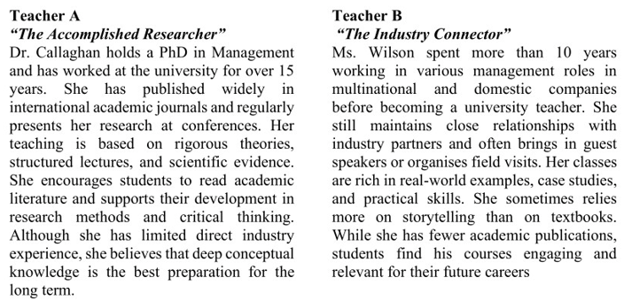
3.2 The preferences of students for two types of teachers
Notes:
By using the AI, we create two teacher profiles in questionnaires,

Slide 12
3.2 The preferences of students for
teacher A and teacher B
Q5: If I was the dean of a business school I would rather hire...
Q6: If I was a parent, I would advise my child to enroll to the class of...
Q7: If I was the owner of a company, I would send my managers for further learning to the class of...
Q8: If I think of what is the most useful for my future career, I would choose…
Q9: If I was a teacher, I would like to be similar rather to…
Finding 2: Teachers should use more
UIC related teaching pedagogy
Notes:
We were asking 5 questions for students’ preference.

Slide 13
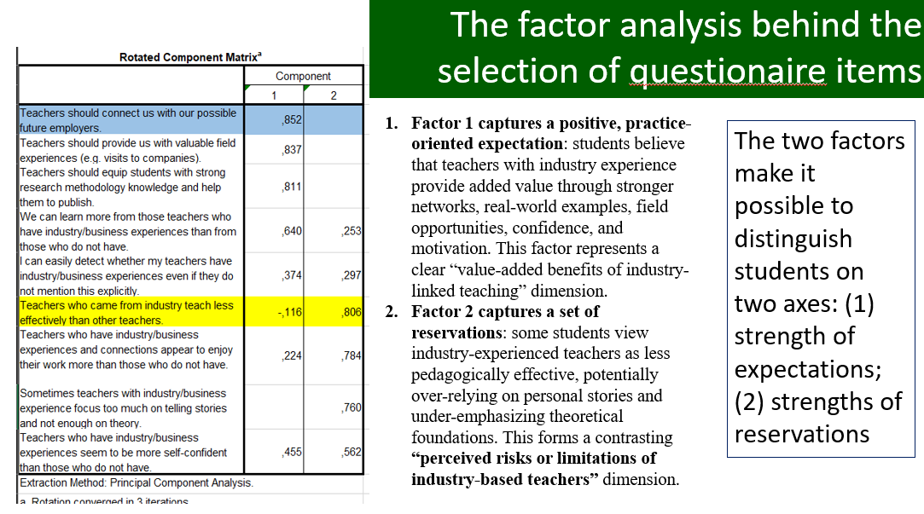
3.3 The preferences of students for different kinds of teachers in function of their attitudes （N=1099）
Four categories of students (based on 2 questionnaire items selected on the basis of factor analysis)
high doubts related to UIC
Sceptical Critics (N=314)
Critical appreciators
(N=239)
Indifferent observers(N=196)
Enthusiastic supporters (N=350)
High UIC expectation
Low UIC expectation
Q11_4 (Teachers should connect us with our possible future employers.)---expectation Q11_7 (Teachers who came from industry teach less effectively than other teachers.)--doubt
low doubts related to UIC

Slide 14
3.3The preferences of students for different kinds of teachers in function of their attitudes (N=1099)
Notes:
The low value shows the preference for teacher A, and the high value show the preference for teacher B.

Slide 15
3.3The preferences of students for different kinds of teachers in function of their attitudes (N=1099)
Finding 3: indicates that students are heterogeneous. Therefore, UIC-based teaching should be differentiated: different groups of students may require different balances between theoretical explanation and practical application.

Slide 16
Thank you for your attention!
Min HUANG
Research assistant
PhD Candidate (ELTE University, Budapest)
E-mail: huangmin@student.elte.hu
Telephone: +36 304137387

Slide 17
Reference
Huang, M., & Halász, G. (2025). Using university-industry cooperation for university and faculty development: A China-Hungary comparative study in fashion education. Journal of Adult Learning, Knowledge and Innovation.
OECD (2017). Supporting entrepreneurship and innovation in higher education in Hungary, https://www.oecd.org/content/dam/oecd/en/publications/reports/2017/11/supporting-entrepreneurship-and-innovation-in-higher-education-in-hungary_g1g7847f/9789264273344-en.pdf (Accessed in December, 2024 ).

Slide 18
UII and different kinds of universities
UIC might decrease the gap between research universities and universities of applied sciences
Notes:
This research focuses on teacehers uic experience on their teaching and sense of self-efficacy, student will be asked the same research question, this is kind of triangulation of data, this is also a way to increase the realiabiltiy of data. This is also answering professor Edit‘ questions.

Slide 19
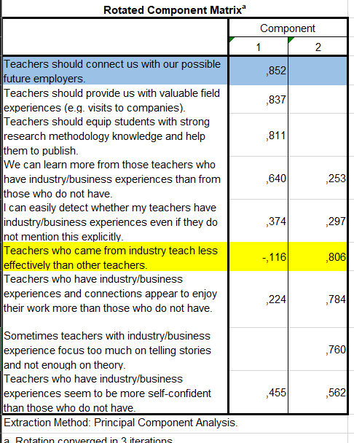
The factor analysis behind the selection of questionaire items
Factor 1 captures a positive, practice-oriented expectation: students believe that teachers with industry experience provide added value through stronger networks, real-world examples, field opportunities, confidence, and motivation. This factor represents a clear “value-added benefits of industry-linked teaching” dimension.
Factor 2 captures a set of reservations: some students view industry-experienced teachers as less pedagogically effective, potentially over-relying on personal stories and under-emphasizing theoretical foundations. This forms a contrasting “perceived risks or limitations of industry-based teachers” dimension.
The two factors make it possible to distinguish students on two axes: (1) strength of expectations; (2) strengths of reservations
Notes:
This research focuses on teacehers uic experience on their teaching and sense of self-efficacy, student will be asked the same research question, this is kind of triangulation of data, this is also a way to increase the realiabiltiy of data. This is also answering professor Edit‘ questions.

